Slide 1
Information technology (IT)

Slide 2
objectives
Stage 01
Stage 02
Stage 03
Stage 04
Defining the meaning of Information Technology (IT)
Learning present simple for descriptions of processes
Learning subject-specific vocabulary
Reading for specific information

Slide 3
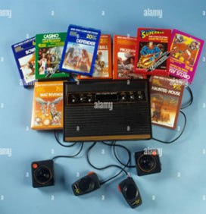
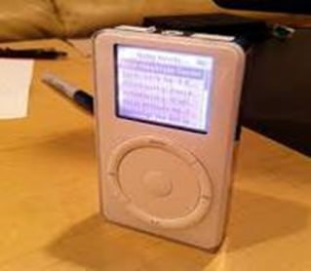
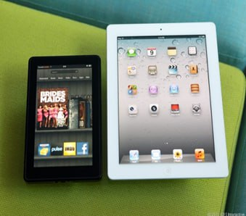
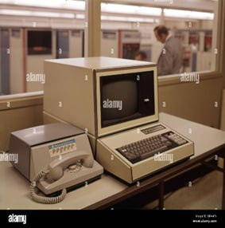

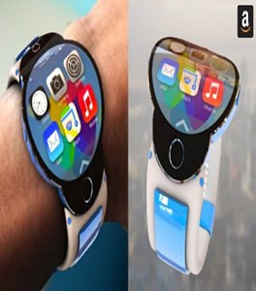
Lead–in activity: Technology Timeline
1940s
1960s
1980s
2000s
2010s
2020s
When these technologies were invented? List them by the given
timeline?

Slide 4

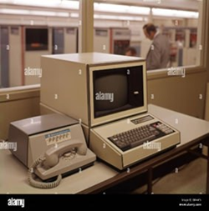



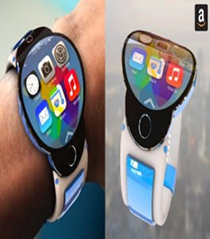
The invention of radio can be traced back to the late 19th century.
The Electronic Numerical Integrator and Computer (ENIAC) was completed in 1945
In the late 1980s and early 1990s.
The original PlayStation was released in 1994 in Japan.
The Microsoft SPOT watches were introduced in 2004.
The Microsoft Tablet PC was introduced in 2002

Slide 5
Food for thought
How have these advancements impacted society, business, and personal lives?
01
02
What is IT?
03
What are their predictions for future developments in IT?

Slide 6

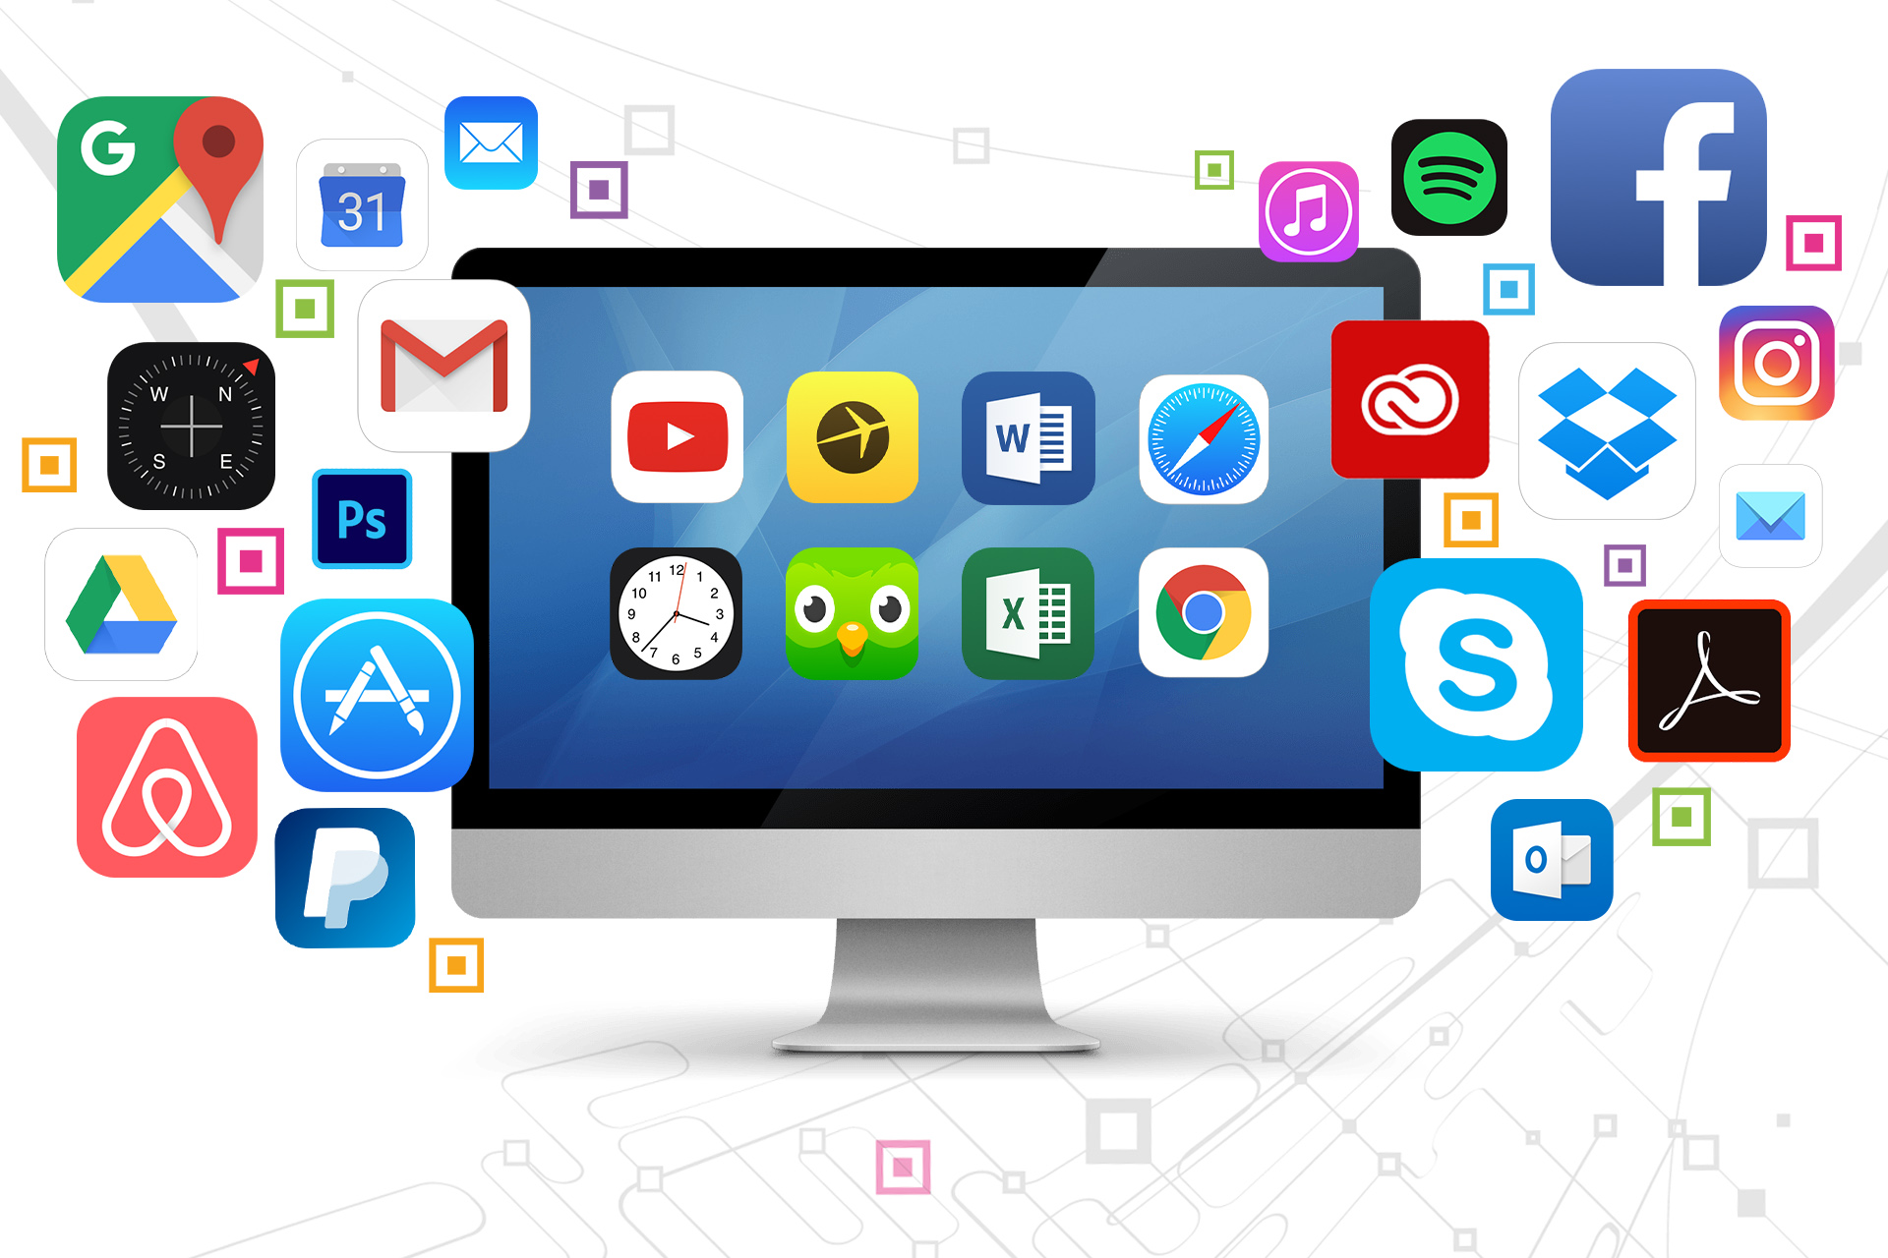
Software
- a program or instruction that makes a computer perform a specific task.

Slide 7
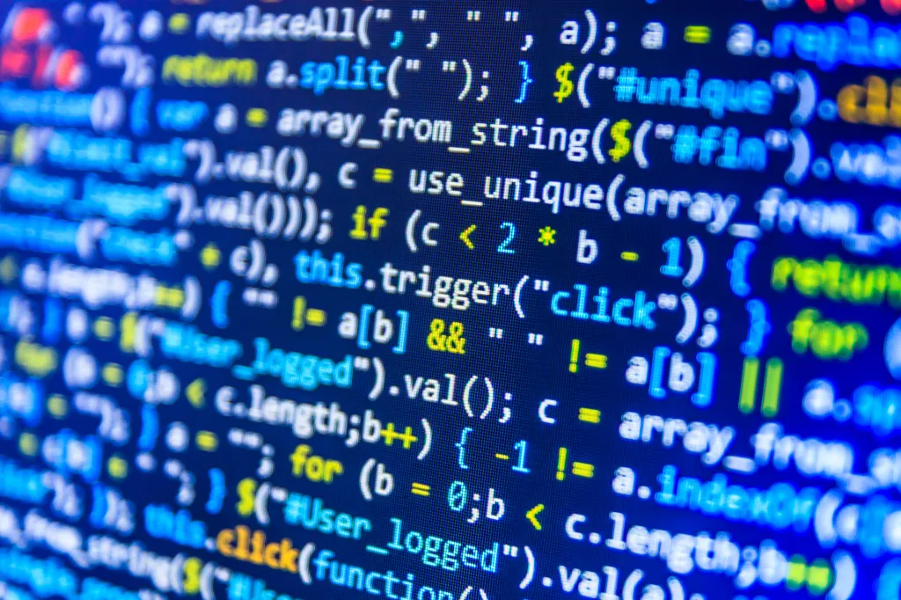

Code
- a set of words and signs that give instructions to a computer.

Slide 8
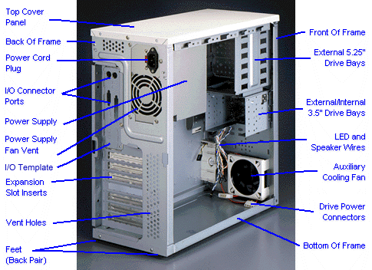
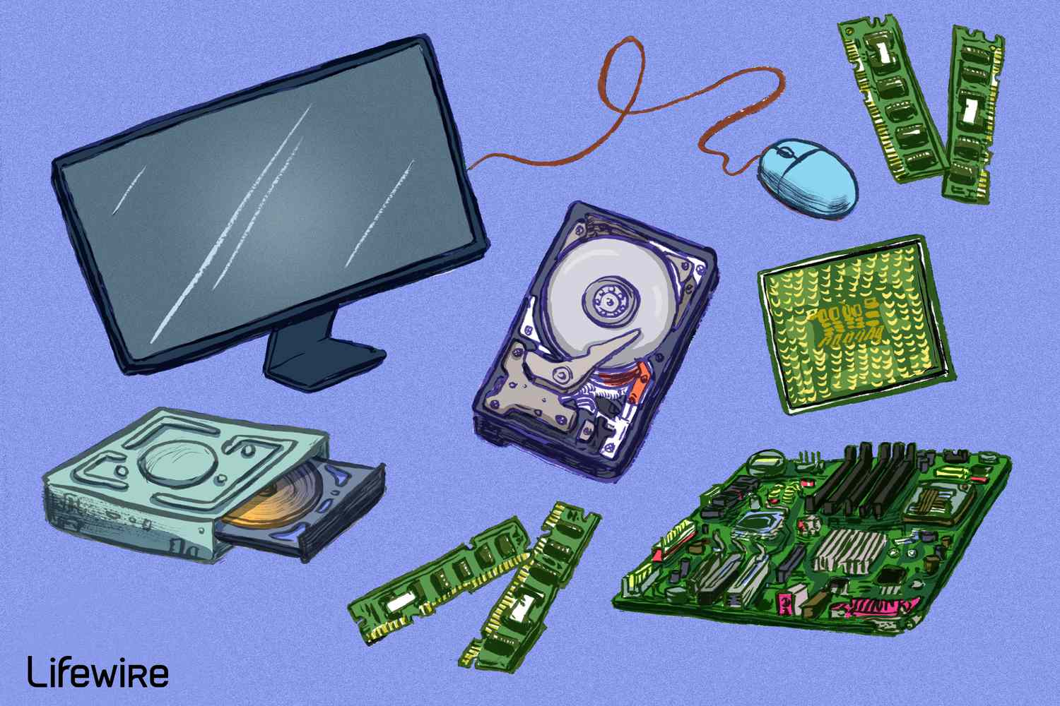
Hardware
- it refers to the physical parts of a computer.

Slide 9
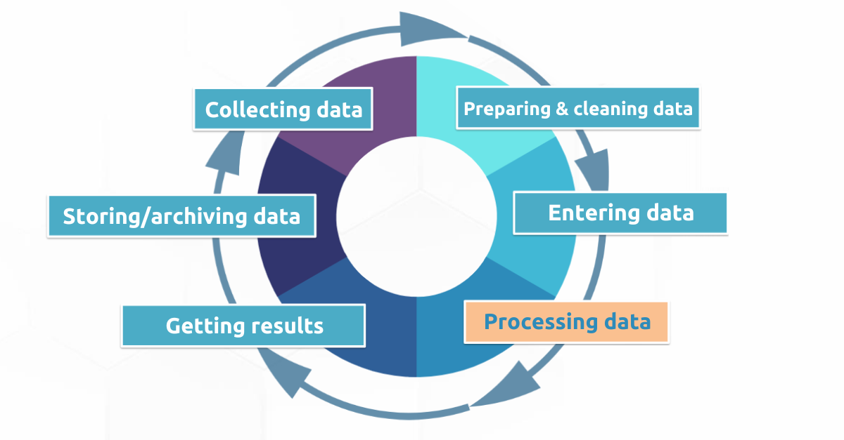
Data processing
- the act of entering, using, or manipulating data with computers.

Slide 10


Technical support
- the task of helping people use and understand technology.

Slide 11


Quality assurance
- the act of checking products for problems.

Slide 12
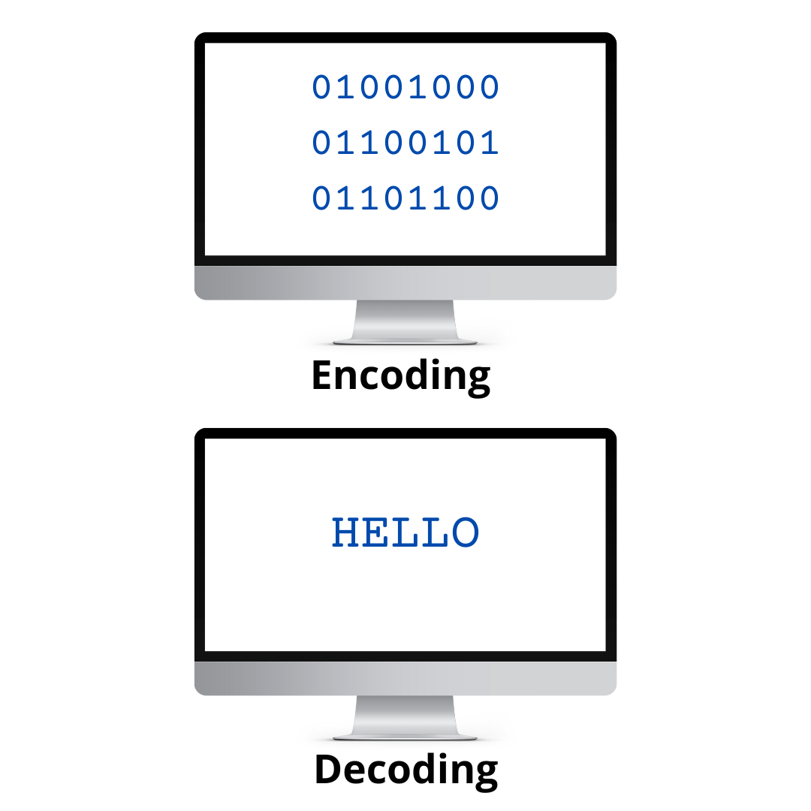
Encoding
- the act of changing data so that no one can read it until it is changed again.

Slide 13
Match the words with the definitions
1. Software | A. the act of checking products for problems
2. Code | B. the act of changing data so that no one can read it until it is changed again.
3. Hardware | C. a program or instruction that makes a computer perform a specific task.
4. Data processing | D. putting secret information into code.
5. Technical support | E. a set of words and signs that give instructions to a computer.
6. Quality assurance | F. refers to the physical parts of a computer.
7. Encoding | G. the act of entering, using, or manipulating data with computers.
8. Information security | H. the task of helping people use and understand technology.

Slide 14
Fill in the blanks with the correct words from the word bank.
quality assurance | data | encoding
1. Enter the ___________ into the computer.
2. The company uses ___________ to protect information.
3. _______________ finds and fixes problems in new products.
data
encoding
Quality assurance

Slide 15
Reading
IT Department Restructuring
DataPro Inc. is growing, and so our workload is increasing. But our IT department is not dealing with this increase effectively. So I am dividing the IT department into three sections: quality assurance, data processing, and information technology. The responsibilities of each section are: Quality Assurance (Testing hardware and Providing technical support), Data Processing (Writing code and Organizing data), and Information Security (Encoding online data transfers and Updating security software).
These changes are not simple or easy. But smaller groups deal with tasks more efficiently than larger ones. See your supervisors for your new section assignment.
Thomas Jenkins,
CEO DataPro Inc
Read the text, then mark the following statements as true (T) or False (F).
___ The IT Department is increasing.
___ Data Processing employees new
encode data.
___ Supervisors know the employees’ new assignments
F
F
T

Slide 16

Listen to a conversation between a DataPro Inc. employee and her supervisor. Choose the correct answers.
1. What is the dialogue mainly about?
A. asking for a raise
B. requesting a transfer
C. assuring product quality
D. improving hardware
2 What can you infer about the employee?
A. She does not like her new section.
B. She has experience with hardware.
C. She does not understand the changes.
D. She creates valuable software.

Slide 17
Grammar: present simple Present Simple is used to talk about habitual actions, general truths, and routines.
Affirmative sentence | Negative sentence | Interrogative sentence
I (you, we, they) load the computer every day | I don’t load the computer every day. | Do you load the computer every day?
She (he, it) loads the computer every day. | She doesn’t load the computer every day. | Does she load the computer every day?

Slide 18
Grammar: present simple Activity 1: Underline the correct form of the verb.
1. When one computer system is set up to communicate with another computer system, connectivity becomes/ become an important system element.
2. People is/are the most important component of the computer system: they create/ creates the computer software instructions and respond to the procedures that those instructions present.
3. The main memory holds/ is hold the instructions and data.
4. Computers play/ plays a crucial role in our everyday lives.
5. Data analysts analyze/ analyzes large datasets to extract meaningful insights.

Slide 19

Activity 2: Watch a video about how to install Software on Windows and write down the verbs that you will hear in the present simple. Then, describe the steps using this tense.

Slide 20
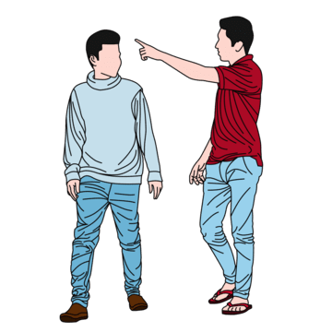
Speaking
With a partner, act out the roles. Then, switch roles.
Use language such as “I have a question about…, I’m in the … section., I have more experience with …”
Student A: You are a supervisor. Speak with Student B to find out about their:
• current section
• desired section
• reason
Student B: You are an employee. Answer Student A’s questions. Make up a name for your supervisor.

Slide 21
Sample Dialogue
Student A (Supervisor): Hi, I have a question about your current work section. Can you tell me which section you're in right now?
Student B (Employee): Sure, I’m currently in the Marketing section.
Student A: And which section are you interested in moving to?
Student B: I’d like to move to the Sales section.
Student A: I see. Can you tell me why you’d like to switch to the Sales section?
Student B: I have more experience with sales strategies and I believe I can contribute more effectively in that area. Also, I find working directly with clients more engaging.
Student A: That makes sense. Thanks for explaining your reasons.
Student B: You’re welcome. If there’s anything else you need, just let me know.

Slide 22
Your home assignment 1. Makeup sentences using today’s target vocabulary. 2. Think about one of the technologies and highlight its key features, uses, advantages, and disadvantages of it.

Slide 23


Do you have any questions? IF NOT, then

